Slide 1

Machine Learning in Python
ISE 589 : Python for ISE

Slide 2
Problem Statement
ISE 589 : Python for ISE
Design an automated spam email / text message classifier.
How?
we are going to use a supervised machine learning algorithm.
the Naïve Bayes Algorithm.
easy to understand, efficient. Your entry to Natural Language Processing (NLP).

Slide 3
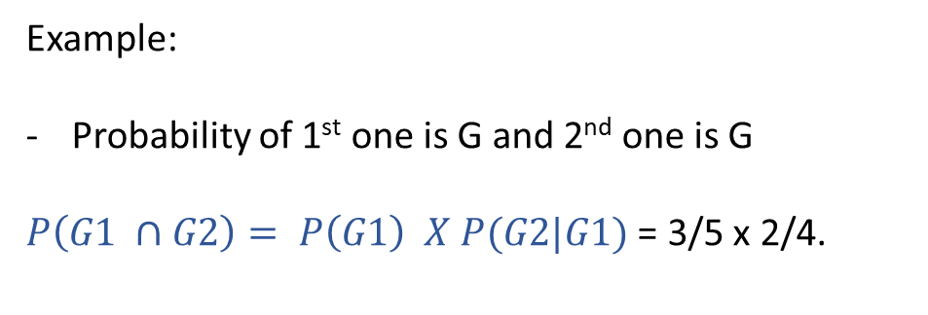
A look back at Conditional Probability
ISE 589 : Python for ISE
General multiplication rule for dependent events:
$$P\left(A ∩B\right)=P\left(A\right) X P(B|A)$$
Scenario:
Drawing balls from a container without replacement.
P(G2 | G1) = 2/4
P(G1) = 3/5
Example:
Probability of 1st one is G and 2nd one is G
$P\left(G1 ∩G2\right)= P\left(G1\right) X P(G2|G1)$ = 3/5 x 2/4.
P( R2 | G1) = 2/4
P(G2 | R1) = 3/4
P(R1) = 2/5
P(R2 | R1) = 1/4

Slide 4



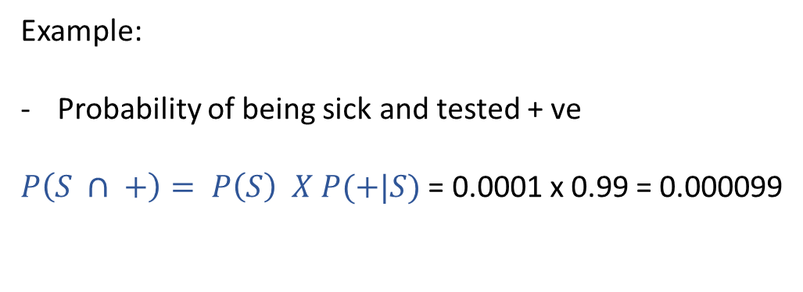

A look back at Conditional Probability
ISE 589 : Python for ISE
General multiplication rule for dependent events:
$$P\left(A ∩B\right)=P\left(A\right) X P(B|A)$$
Scenario:
On average 1 / 10,000 people suffer from a rare auto-immune disease.
There is a test that can detect this disease with 99% accuracy.
P(+ | S) = 0.99
$$P\left(S ∩ +\right)$$
P(S) = 0.0001
Example:
Probability of being sick and tested + ve
$P\left(S ∩ +\right)= P\left(S\right) X P(+|S)$ = 0.0001 x 0.99 = 0.000099
P( - | S) = 0.01
$$P\left(S ∩−\right)$$
P(+ | H) = 0.01
$$P\left(H ∩ +\right)$$
P(H) = 0.9999
P(- | H) = 0.99
$$P\left(H ∩−\right)$$

Slide 5


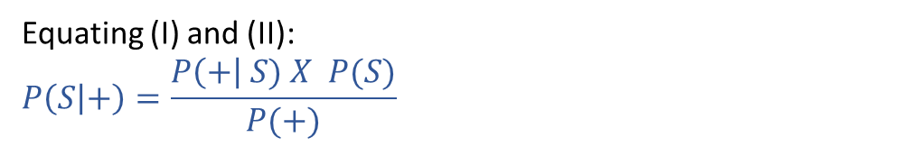

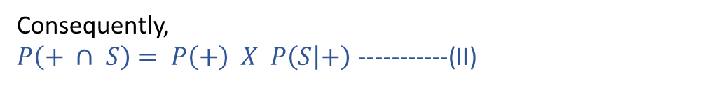

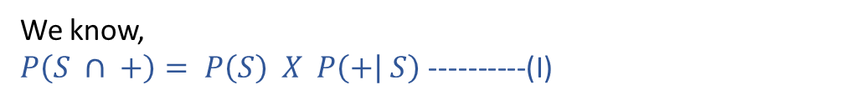
Bayes Theorem
ISE 589 : Python for ISE
The probability of an event conditional on a new piece of evidence (the posterior probability) is a function of the probability of the evidence given the event has occurred and the prior probabilities of the event and the evidence.
We know,
$P\left(S ∩ +\right)= P\left(S\right) X P\left(+ | S\right)$ ----------(I)
P(+ | S) = 0.99
$$P\left(S ∩ +\right)$$
P(S) = 0.0001
Consequently,
$P\left(+ ∩ S\right)= P\left(+\right) X P\left(S | +\right)$ -----------(II)
P( - | S) = 0.01
$$P\left(S ∩−\right)$$
Equating (I) and (II):
$$P\left(S | +\right)=\frac{P\left(+\right| S) X P(S)}{P(+)}$$
P(+ | H) = 0.01
$$P\left(H ∩ +\right)$$
P(H) = 0.9999
P(- | H) = 0.99
$$P\left(H ∩−\right)$$

Slide 6

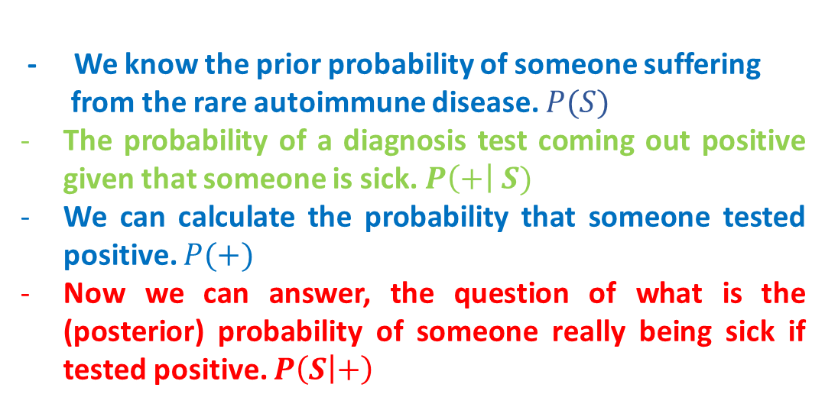
Bayes Theorem Continued
ISE 589 : Python for ISE
The probability of an event conditional on a new piece of evidence (the posterior probability) is a function of the probability of the evidence given the event has occurred and the prior probabilities of the event and the evidence.
P(+ | S) = 0.99
$$P\left(S | +\right)=\frac{P\left(+\right| S) X P(S)}{P(+)}$$
$$P\left(S ∩ +\right)$$
P(S) = 0.0001
- We know the prior probability of someone suffering
from the rare autoimmune disease. $P(S)$
The probability of a diagnosis test coming out positive given that someone is sick. $P\left(+\right| S)$
We can calculate the probability that someone tested positive. $P(+)$
Now we can answer, the question of what is the (posterior) probability of someone really being sick if tested positive. $P\left(S | +\right)$
P( - | S) = 0.01
$$P\left(S ∩−\right)$$
P(+ | H) = 0.01
$$P\left(H ∩ +\right)$$
P(H) = 0.9999
P(- | H) = 0.99
$$P\left(H ∩−\right)$$

Slide 7

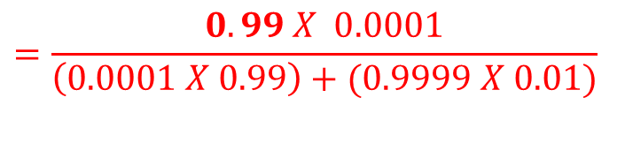

Bayes Theorem Continued
ISE 589 : Python for ISE
The probability of an event conditional on a new piece of evidence (the posterior probability) is a function of the probability of the evidence given the event has occurred and the prior probabilities of the event and the evidence.
P(+ | S) = 0.99
$$P\left(S | +\right)=\frac{P\left(+\right| S) X P(S)}{P(+)}$$
$$P\left(S ∩ +\right)$$
P(S) = 0.0001
P( - | S) = 0.01
$$=\frac{0.99 X 0.0001}{\left(0.0001 X 0.99\right)+(0.9999 X 0.01)}$$
$$P\left(S ∩−\right)$$
P(+ | H) = 0.01
$$=\frac{0.99 X 0.0001}{\left(0.0001 X 0.99\right)+(0.9999 X 0.01)}$$
$$P\left(H ∩ +\right)$$
$$=0.0098 <1\%$$
P(H) = 0.9999
P(- | H) = 0.99
$$P\left(H ∩−\right)$$

Slide 8
Bayes Theorem and Spam Classification
ISE 589 : Python for ISE
PRIORS
POSTERIORS
P(easy| S) = 1/3
P(S) = 3/8
Using Bayes Theorem
SPAM
Win Money Now!!!
Dallaz and money coming yo way!
Make cash easy!
P( money | S) = 2/3
P(S | easy) = 1/2
Email / text
HAM
Call me back asap.
Let me know if the money has deposited.
The Python midterm? Super easy!.
Meet near Bell tower by 5.
No, only home work 2.
P(S | money) = 2/3
P(easy | H) = 1/5
P(H) = 5/8
P(money | H) = 1/5

Slide 9
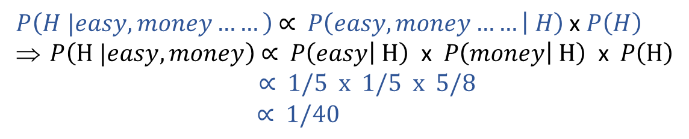
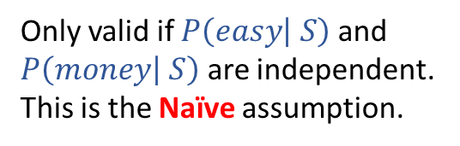
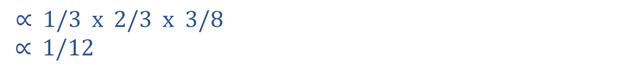
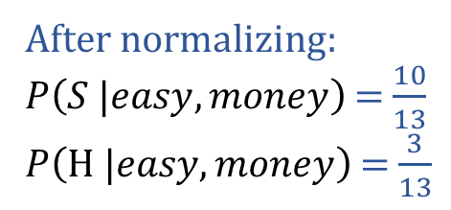
Naïve Bayes Algorithm
ISE 589 : Python for ISE
Obviously we are not going to say whether an email is spam or ham just on the basis of one or two words. In general we can extend the Bayes theorem for multiple words. Our theorem then becomes:
$P\left(S |easy, money……\right) \text{∝} P\left(easy, money…… | S\right)$ x $P\left(S\right)$
$P\left(S |easy, money\right)\text{ ∝} P\left(easy | S\right) \text{x} P\left(money | S\right) \text{x} P\left(S\right)$
Only valid if $P\left(easy | S\right)$ and
$P\left(money | S\right)$ are independent.
This is the Naïve assumption.
$\text{∝} \text{1/3 }\text{x}\text{ 2/3 }\text{x} 3/8$
$$\text{∝} 1/12$$
$P\left(H |easy, money……\right) \text{∝} P\left(easy, money…… | H\right)$ x $P\left(H\right)$
$P\left(H |easy, money\right)\text{ ∝} P\left(easy | H\right) \text{x} P\left(money | H\right) \text{x} P\left(H\right)$
$\text{∝} \text{1/}\text{5} \text{x}\text{ 1/5 }\text{x} 5/8$
$\text{∝} 1/40$
After normalizing:
$P\left(S |easy, money\right)$ = $\frac{10}{13}$
$P\left(H |easy, money\right)$ = $\frac{3}{13}$
Much higher probability for an email / text to be spam
If it contains the words “easy” and “money”.

Slide 10



In Class Exercise
ISE 589 : Python for ISE
“Learns” on the dataset -> supervised ML algorithm
New test data
Naïve Bayes Classifier
Trained Model
Spam/Ham
text dataset
Spam/Ham
detection on test data
https://archive.ics.uci.edu/ml/datasets/sms+spam+collection
$P\left(easy, money | S\right)$ x $P\left(S\right)$
$$P\left(S |easy, money\right)$$

Slide 11



In Class Exercise – Score Metrics
ISE 589 : Python for ISE
$$Accuracy= \frac{A+D}{A+B+C+D}$$
Ground Truth
Spam Email
Ham Email
$$Precision= \frac{A}{A+B}$$
A
B
Detected as Spam Email
$$Recall= \frac{A}{A+C}$$
C
D
Detected as
Ham Email

